Slide 1
Axiom of Choice
“The Axiom of Choice is obviously true, the well-ordering principle obviously false, and who can tell about Zorn's lemma?” - Jerry Bona

Slide 2
What is Math
Start with some assumptions (axioms)
Deduce the rest

Slide 3
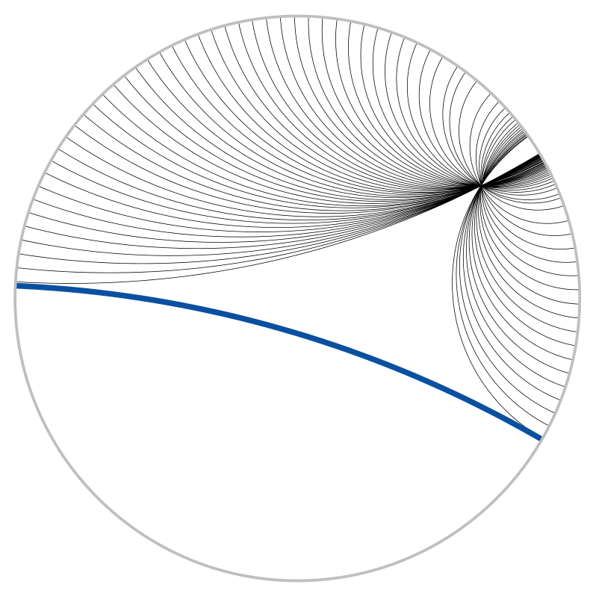
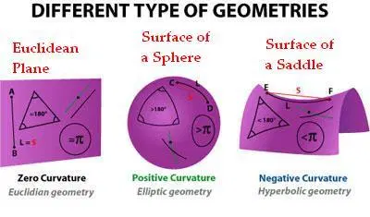
An Example: Euclidean Geometry
To draw a straight line from any point to any point.
To produce (extend) a finite straight line continuously in a straight line.
To describe a circle with any centre and distance (radius).
That all right angles are equal to one another.
states that through any given point not on a line there passes exactly one line parallel to that line in the same plane.

Slide 4
A Quick Intro
The C in ZFC
For any collection of non-empty sets, one can construct a new set containing an element from each set in the original collection

Slide 5
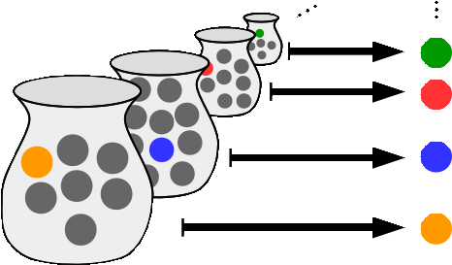
More Formally
Choice function: Given a collection X comprised of non-empty sets, a choice function f is a function such that for every set A in X, f(A) is an element of A.
Therefore Axiom of Choice could be restated as for any such X such that no sets in X is empty, there exist some choice function f
Seems very intuitively true…
Notes:
Axiom of choice - Wikipedia

Slide 6
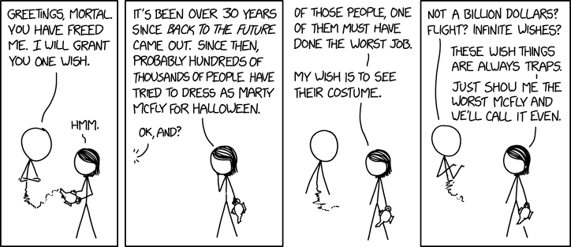
Well-ordering theorem
Every set can be well ordered:
Well ordered: every non empty subset of S has a least element

Slide 7
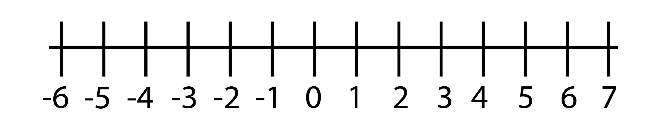
Why this might not seem true
Define our set S as all the reals in (1,2) not inclusive
What is the least element?

Slide 8

But the well ordering principle and the axiom of choice are equivalent

Slide 9
Equivalency under ZF
Well ordering implies axiom of choice:
Every set can be well ordered -> there is some least element
Let the choice function f be the one that selects the least element from each set
There is a way to select an element from each set

Slide 10
First some definitions
Ordinal is a generalized concept of a natural number that is used to order things
Cardinal are just generalized concepts to described size

Slide 11
Equivalency under ZF
Axiom of choice implies well ordering
By the axiom of choice there exist a choice function f on a set S
With f we can build a bijection between S and some ordinal:
Map f(S) to 0
Repeat until finished:
Add what has been chosen out already into set X
Map f(S\X) to the next ordinal
Works by principle of Transfinite Induction

Slide 12

Independence
Gödel proved ZF with C is consistent
Cohen proved ZF + not C is also consistent
Therefore showing C is independent of ZF and must be taken as an axiom

Slide 13
Zorn’s Lemma
Equivalent to Axiom of Choice under ZF
Zorn’s Lemma: If S is any nonempty partially ordered set in which every chain has an upper bound, then S has a maximal element.
a partial order (poset) is any binary relation that is reflexive, antisymmetric, and transitive.
For the following proof: essentially a generalized idea of <=
A chain is a total order of a subset of a poset
A total order is just a poset where every element is comparable

Slide 14
Every connected graph has a spanning tree
Let G be a connected graph with possibly infinite vertices
Let S be a set of all trees that form a sub graph relationship
Consider an arbitrary chain T in S
Let T* be the union of all the trees in the chain
T* establishes a clear upper bound
T* has to be a tree
It can’t be disconnected because T* is formed by a union of trees that are sub graphs of each other.
It can’t contain a cycle because T* is formed by a union of trees. Consider if there were a cycle, this cycle must appear at some point in the chains which contradicts the fact that at each point of the chain, it is a tree.
By Zorn's lemma S has a maximal element
That maximal element is a spanning tree
AFSOC that it is not a spanning tree, than there is some vertex you can connect which won’t form a cycle, but this contradicts the claim that the element is maximal

Slide 15
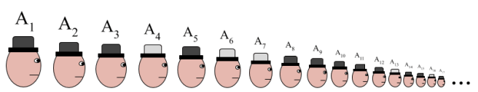
This fun hat problem
There are a countable infinity of prisoners lined up with randomly assigned hats (either black or white). They each know their position in line. Before they have to guess there hat color they are allowed to convene and discuss a strategy. Once they go back in line, the prisoners will have to guess there hat color, if they guess wrong they die. They can see everybody’s hat color in front of them (a countably infinite amount) but not the people behind them. Is there a strategy such that only a finite of them die?

Slide 16
Here’s the Strategy
First two sequences (x and y) of numbers are in the same equivalence class if the two sequences are identical after a finite number of digits in the sequence.
For example 101010000000000000… and 1231412300030000000000…
This will give you a set of equivalence classes.
Each prisoner can identify which equivalence class they are in because they can see a infinite amount of hats in front of them, they can only not see a finite amount of hats behind them.
Citing axiom of choice, after identifying the equivalence class they are in, the prisoners can select a element from the equivalence class they are in. Call this element r.
The prisoners then guess solely based on this representative element r.
Since the actual sequence and the r is in the same equivalence class, they only differ in finite amount of places and these finite prisoners die while the rest of the prisoners go free.
Notes:
1011111101010010101010101010101010101010
10111110000001010101010101010110101010101
0000111

Slide 17
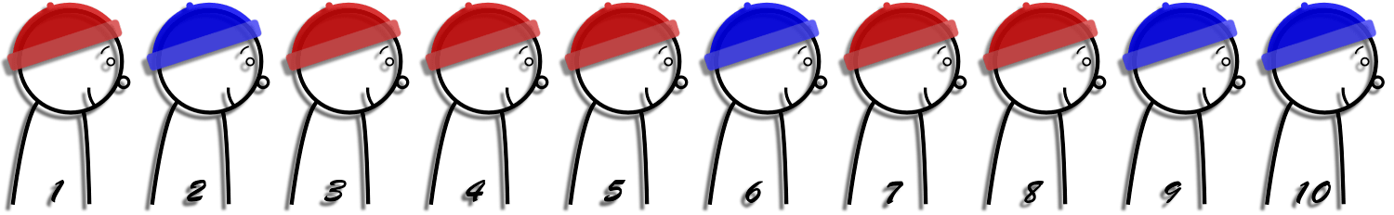
Extensions
The exact same strategy would work if there were more colors of hats
If prisoners can hear what people before them guessed, at most one prisoner will die.
The first person guesses white if there is a odd number of differences between his observed sequence and the representative sequence and black otherwise. Remaining prisoners can deduce what there own hat colors are.

Slide 18
Some more applications
For every infinite set A, there is a bijective map between the sets A and A×A.
If two sets are given, then either they have the same cardinality, or one has a smaller cardinality than the other.
Given two non-empty sets, one has a surjection to the other
The Cartesian product of any family of nonempty sets is nonempty
Every vector space has a basis.

Slide 19
“The Axiom of Choice is obviously true, the well-ordering principle obviously false, and who can tell about Zorn's lemma?” - Jerry Bona

Slide 20
Godel’s Incompleteness Theorem
No consistent system can prove all true statements
There are statements that the system will never be able to prove or disprove
No system can prove that is consistent

Slide 21
Sources
Axiom of Choice (vanderbilt.edu)
The Axiom of Choice (Stanford Encyclopedia of Philosophy)
The Weirdest Consequence of the Axiom of Choice – Rising Entropy
Zorn's lemma | mathematics | Britannica
Zorn's Lemma -- from Wolfram MathWorld
combinatorics - Is it true that a connected graph has a spanning tree, if the graph has uncountably many vertices? - Mathematics Stack Exchange
zorn’s lemma | Math For Fun (wordpress.com)
Well-Ordering Theorem – ProofWiki
acwozl.pdf (uio.no)

